Slide 1
Automatic Detection and Segmentation of Brain Tumor Using Random Forest Approach
Bachelor Seminar WS 2020/21
“Medical Image Computing and e-Health”
08.01.2020
Prof. Dr. Heinz Handels, Prof. Dr. Josef Ingenerf, Prof. Dr.-Ing. Marcin Grzegorzek and coworkers
Institute of Medical Informatics
Universität zu Lübeck

Slide 2
Outline
Motivation
Basics
Binary Decision Trees (BDT)
Random Forest (RDF)
Methods
Application in Paper
Results of the Experiment
Conclusion

Slide 3
Motivation
Author: Zoltán Kapás, Release: 2016
Building reliable procedure for tumor detection
Primary Goal: Early Detection
Secondary Goal: Segmentation
Currently challenging due to variety of anatomical structures
Based on supervised machine learning

Slide 4
Basics

Slide 5
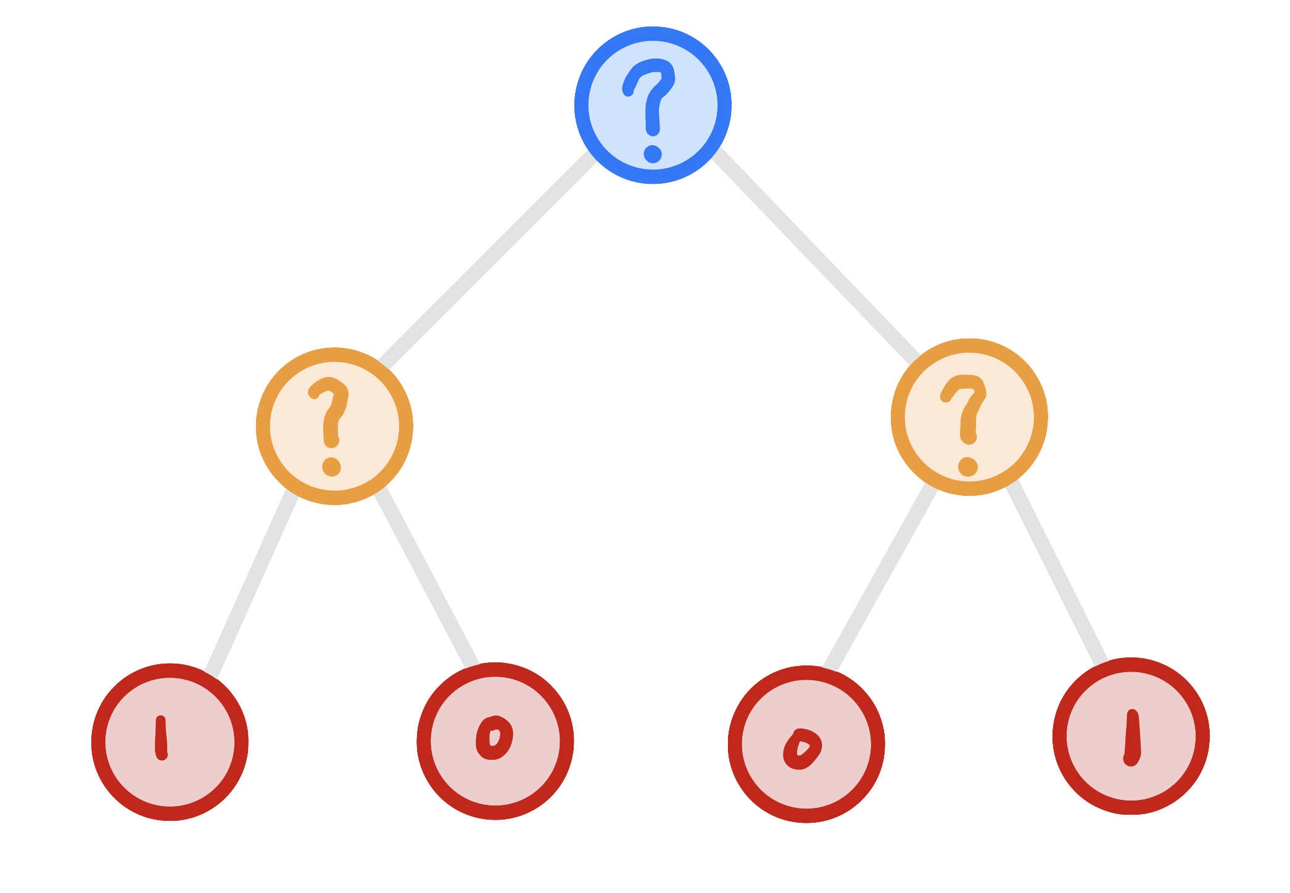
Basics - BINARY DECISION TREE
Hierarchy of two-way decisions
Learn Classification of training set
Decision at leaf node
ROOT
SPLIT
LEAF

Slide 6
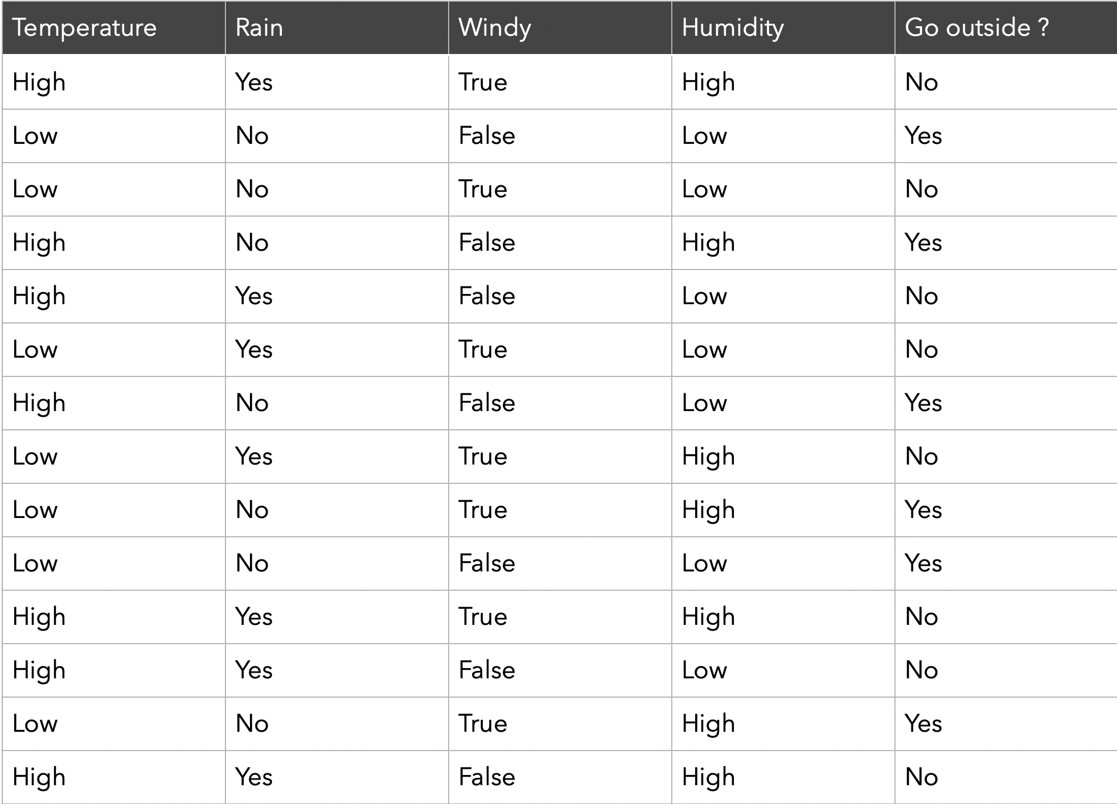
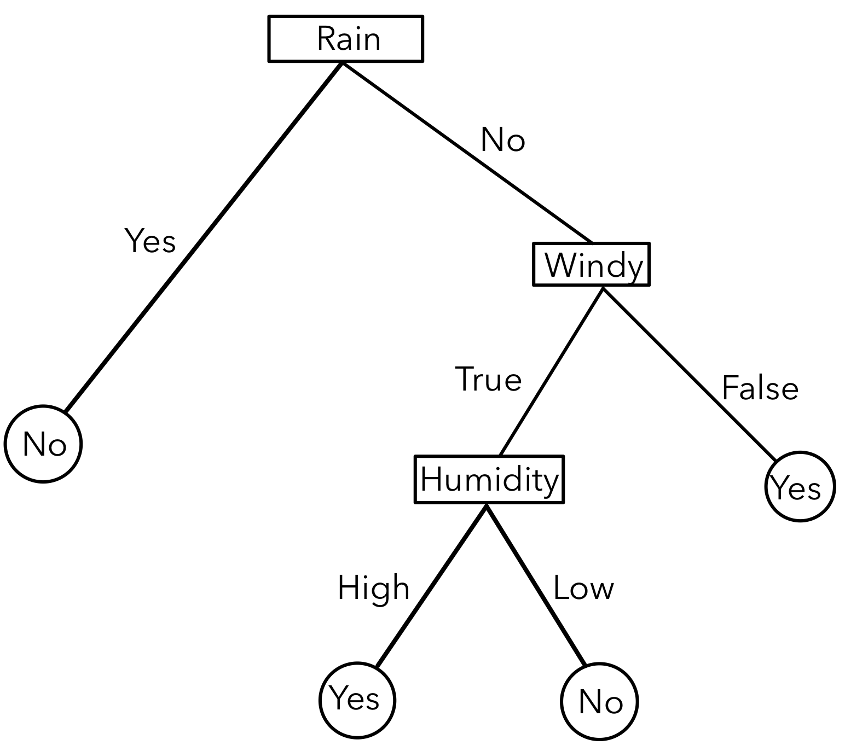
Basics - BINARY DECISION TREE

Slide 7
Building a BDT
HOW
GIVEN: DATA SET
PICK FEATURE
SET THRESHOLD
DIVIDE DATA SET INTO TWO SUBGROUPS
CONSIDER SUBSETS INDIVIDUALLY

Slide 8
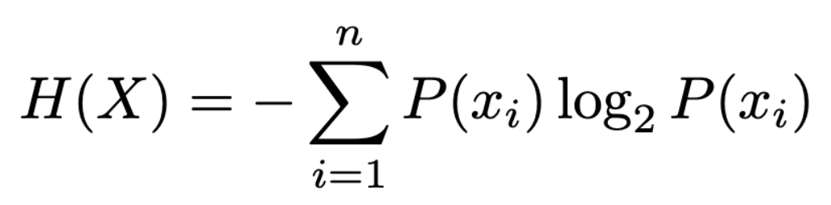

Building a BDT - HOW TO PICK?
Pick feature with most efficient division
Entropy → Information Gain
Test every feature
Leaf node if subset is indistinguishable
Entropy:
Information Gain:

Slide 9
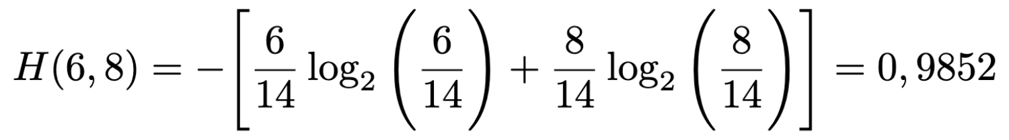
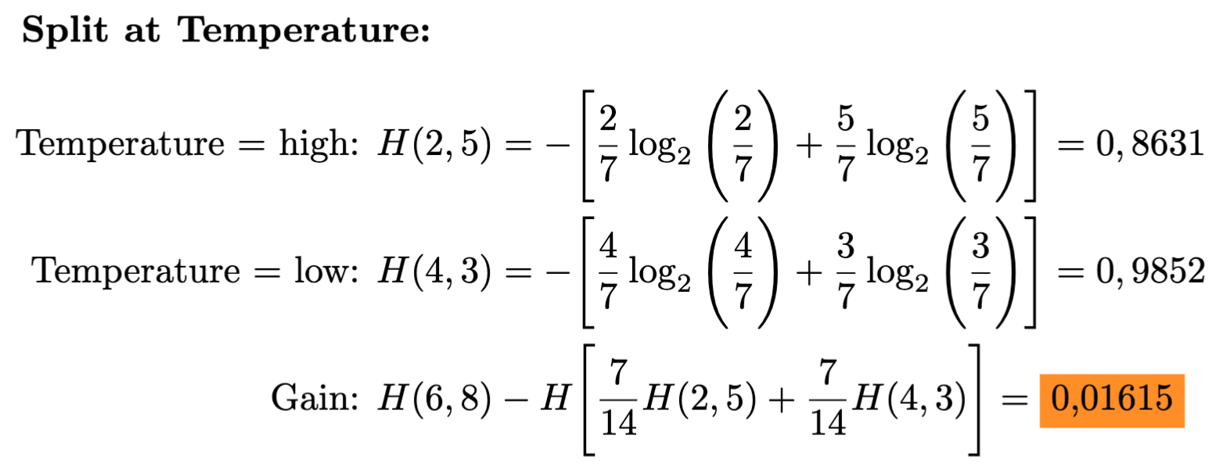
Information Gain

Slide 10
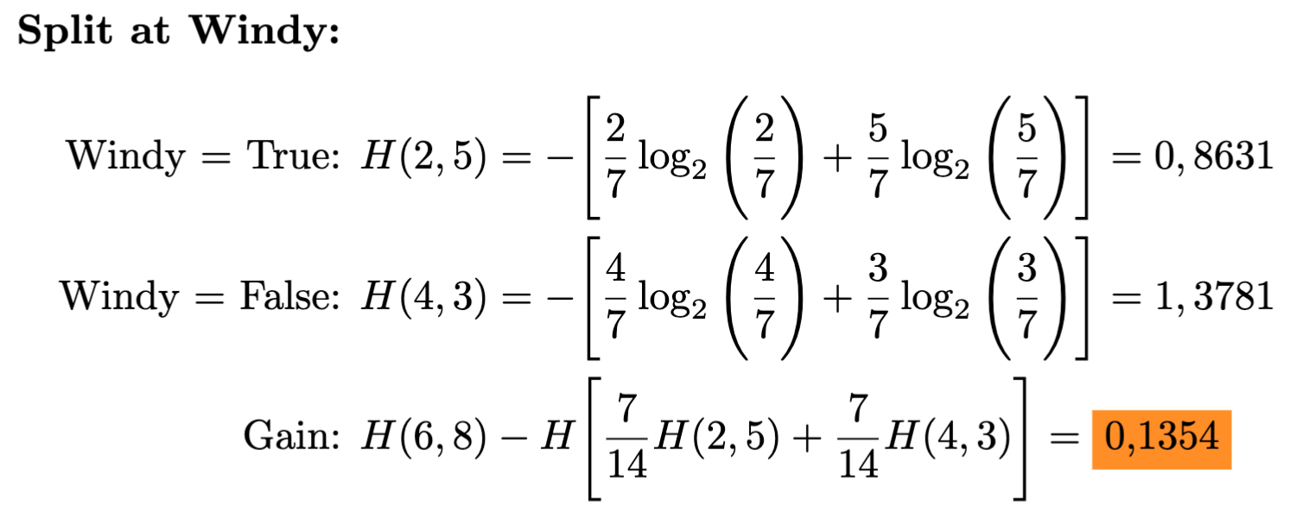
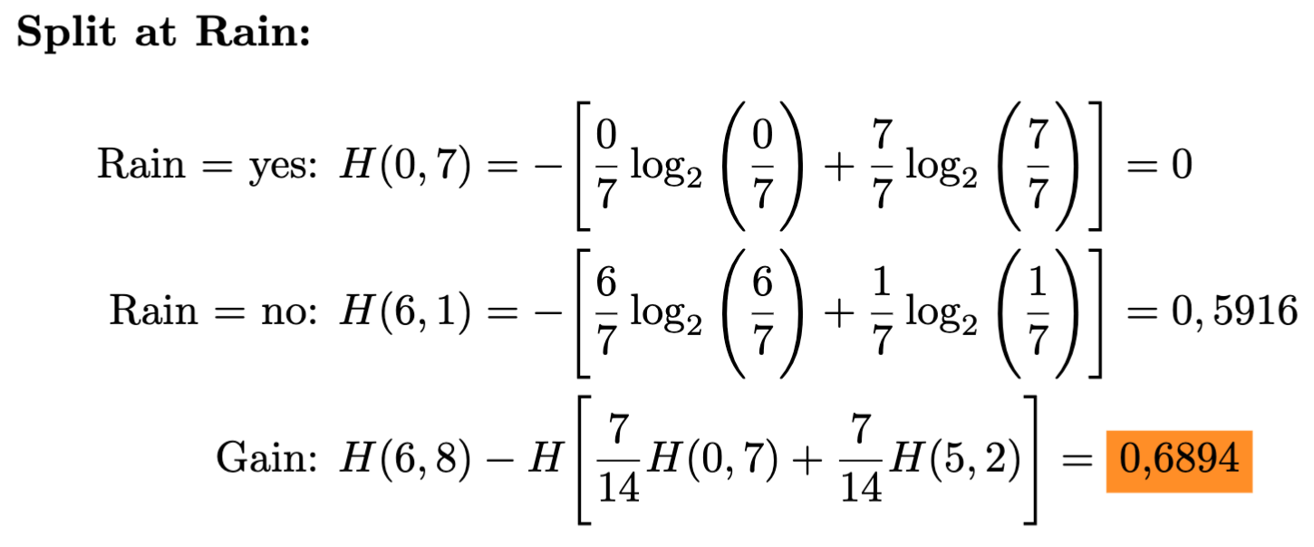
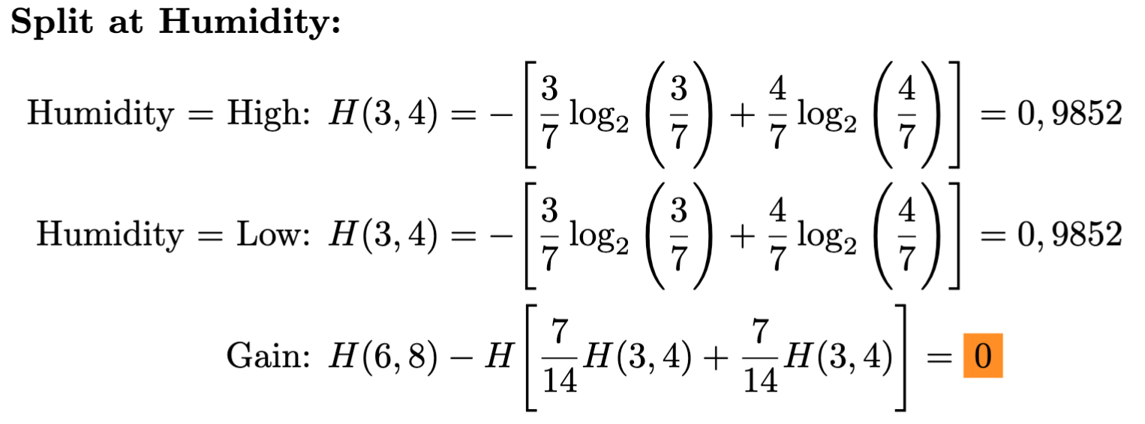
Information Gain

Slide 11
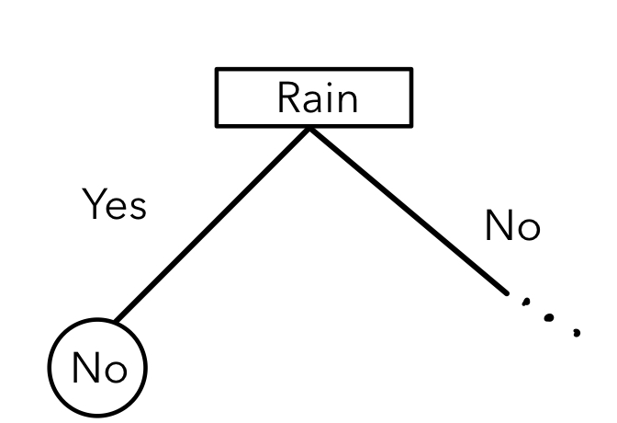
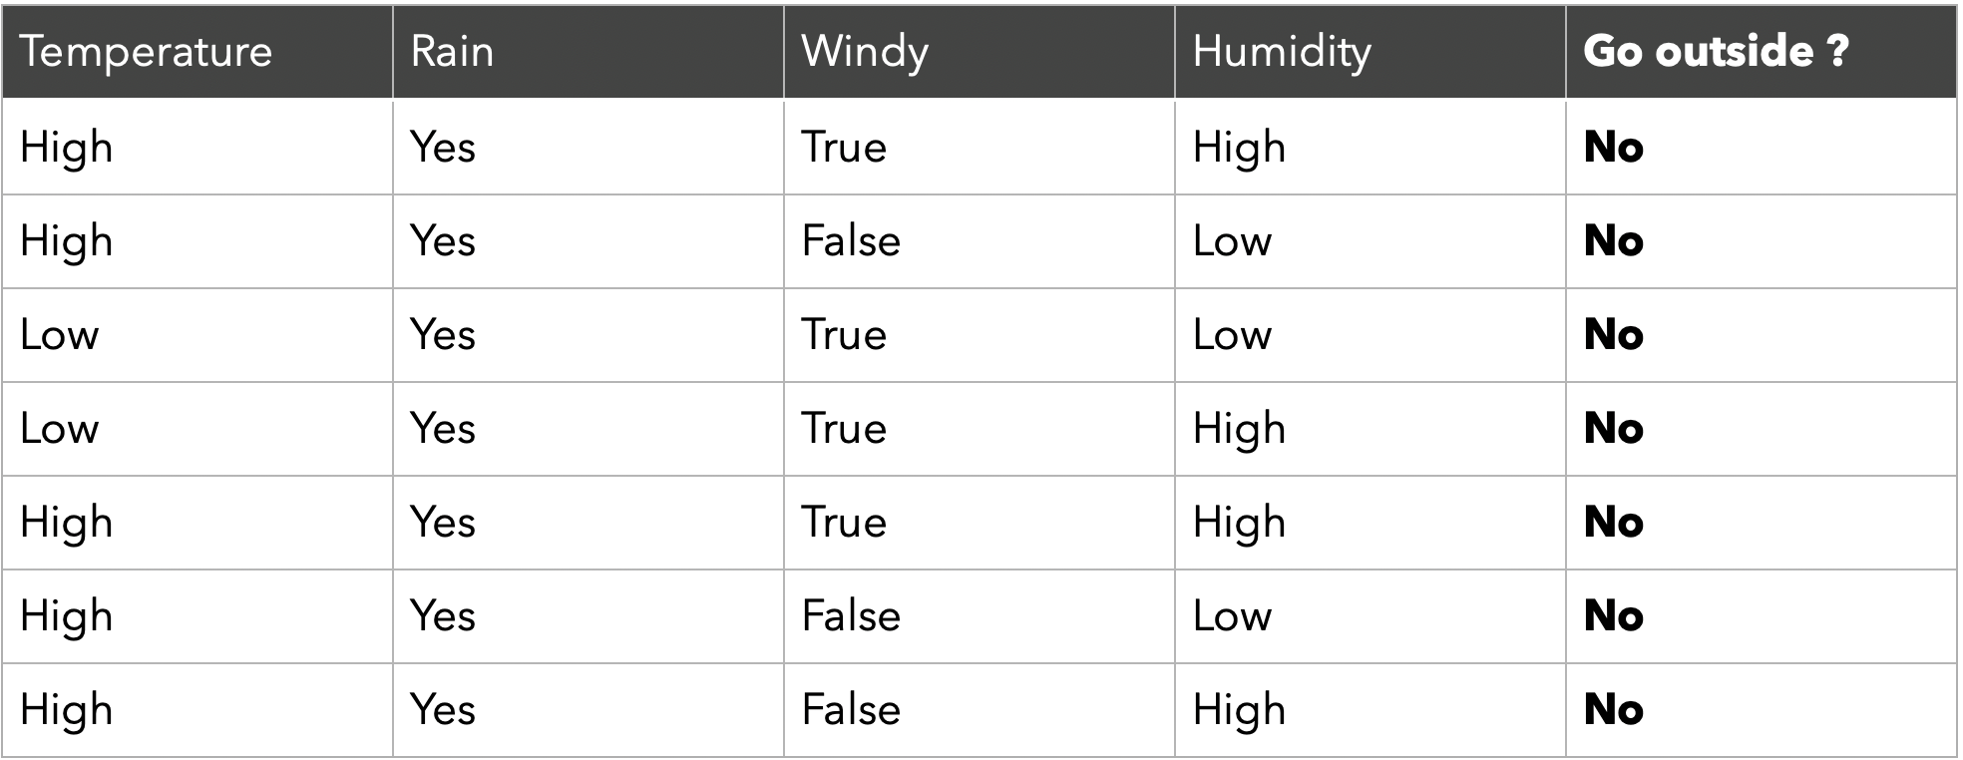
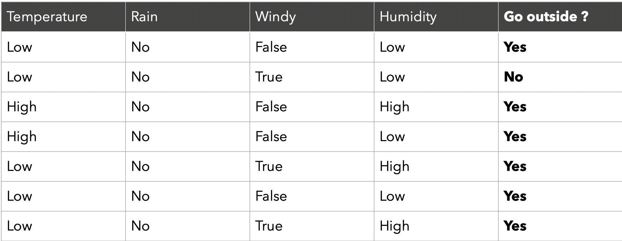
Split subsets

Slide 12
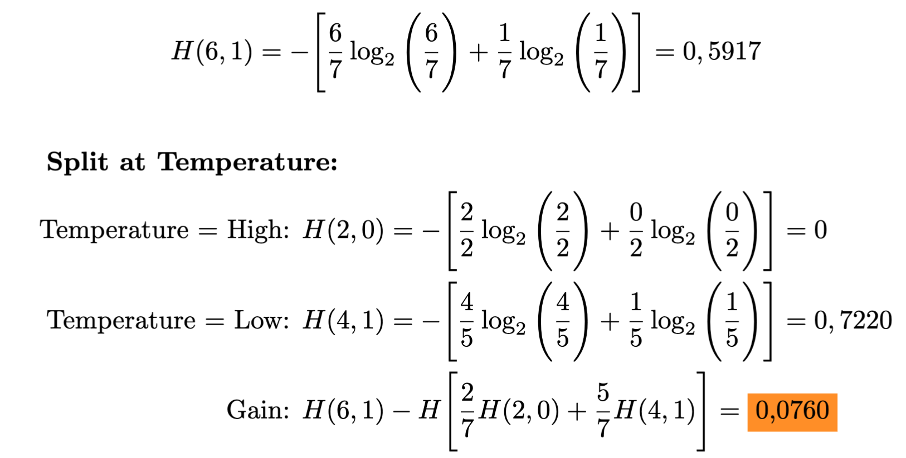
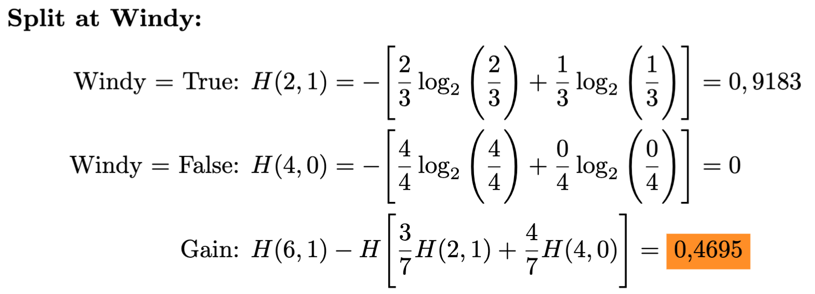
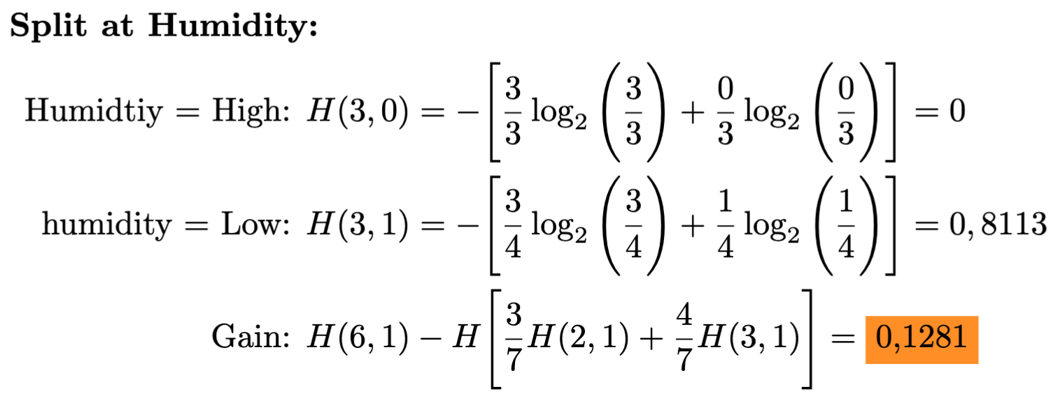
Split subsets

Slide 13
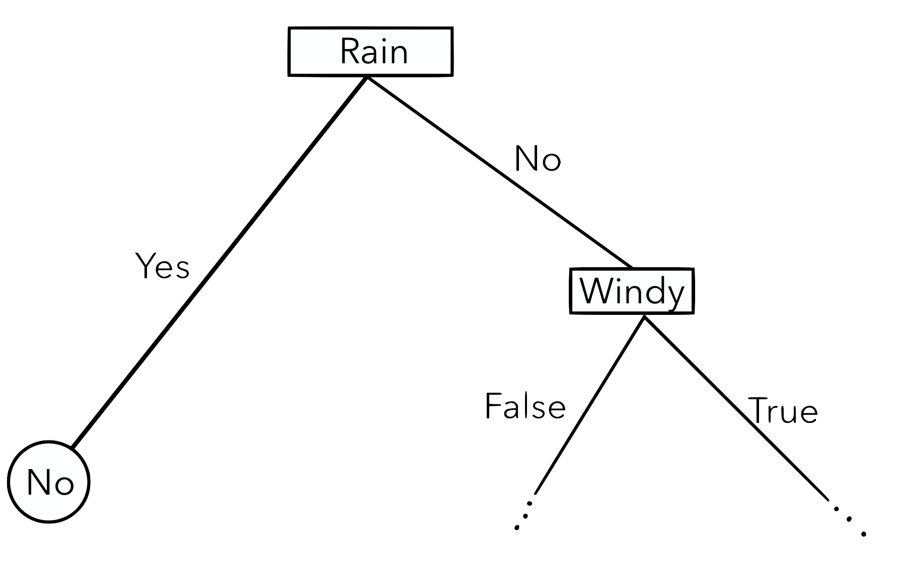
Split subsets

Slide 14
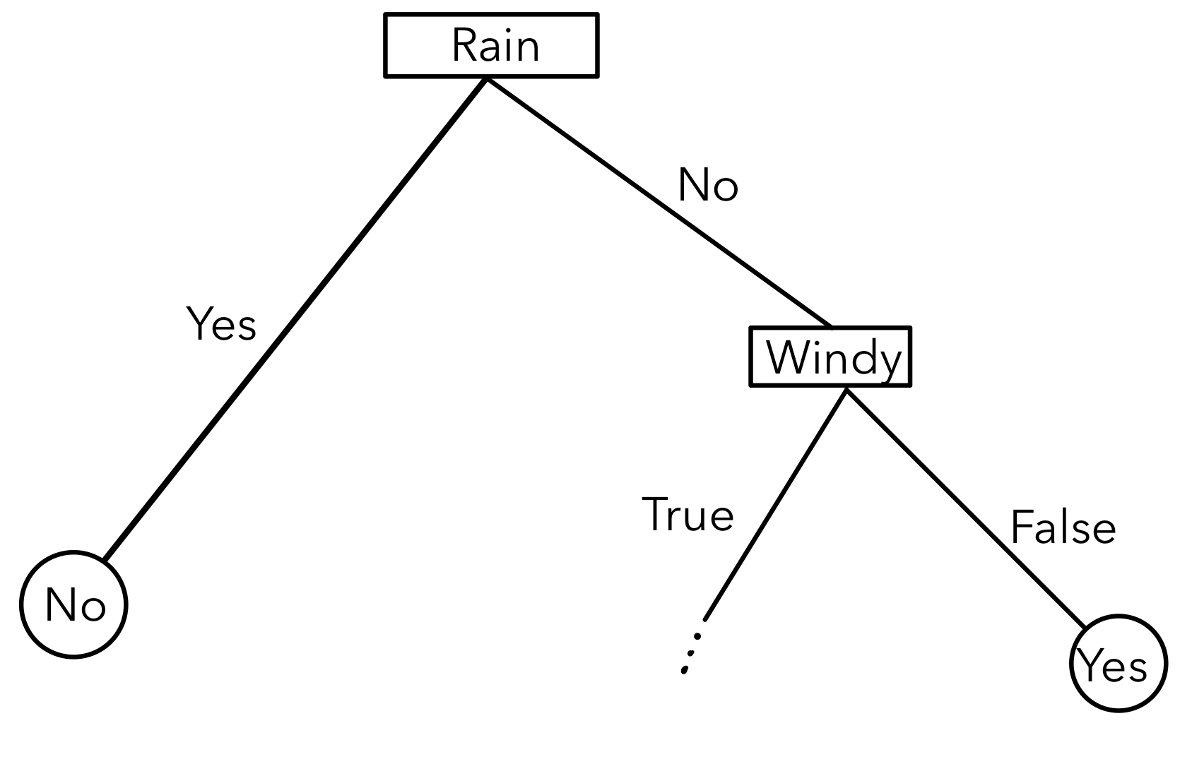
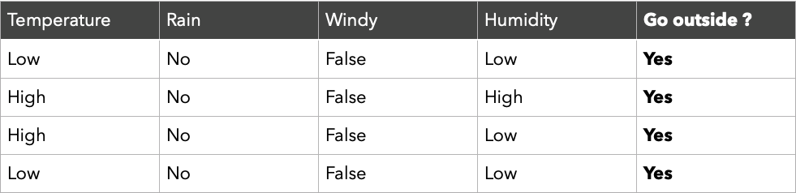
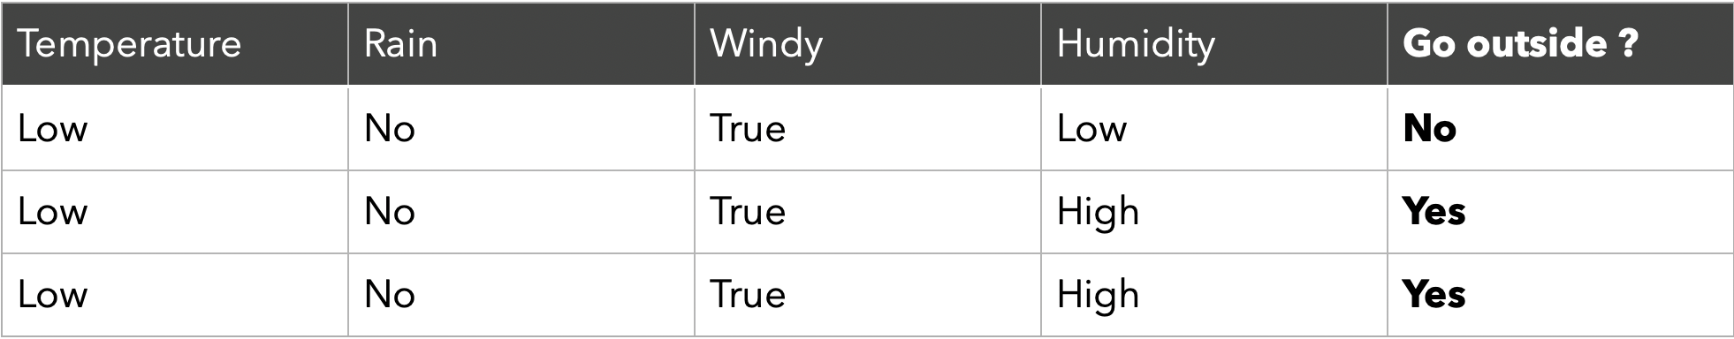
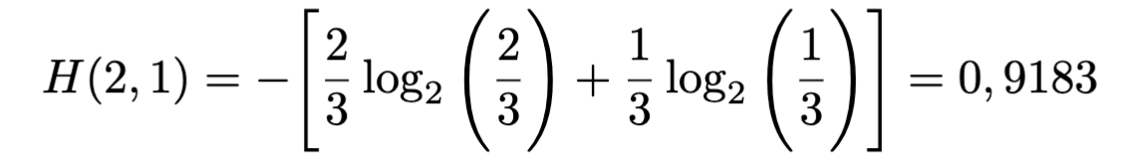
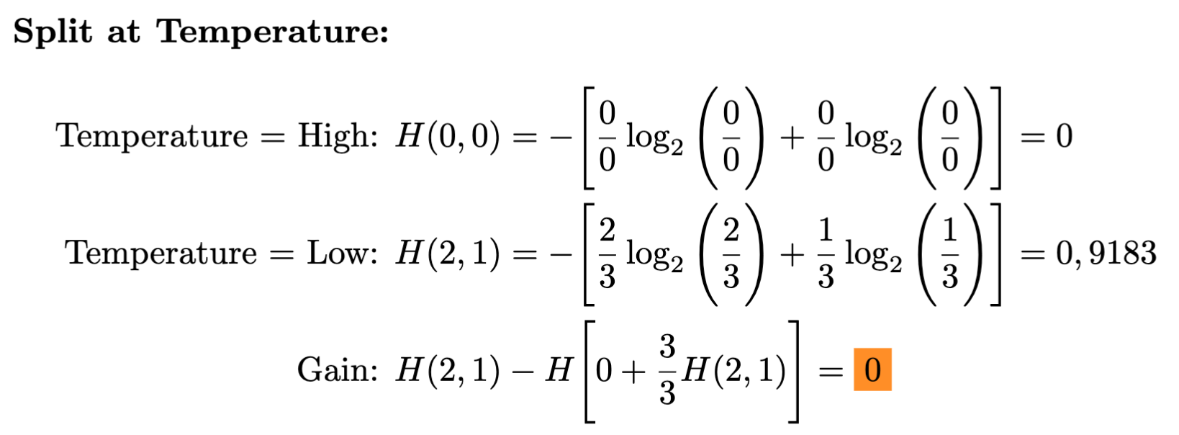
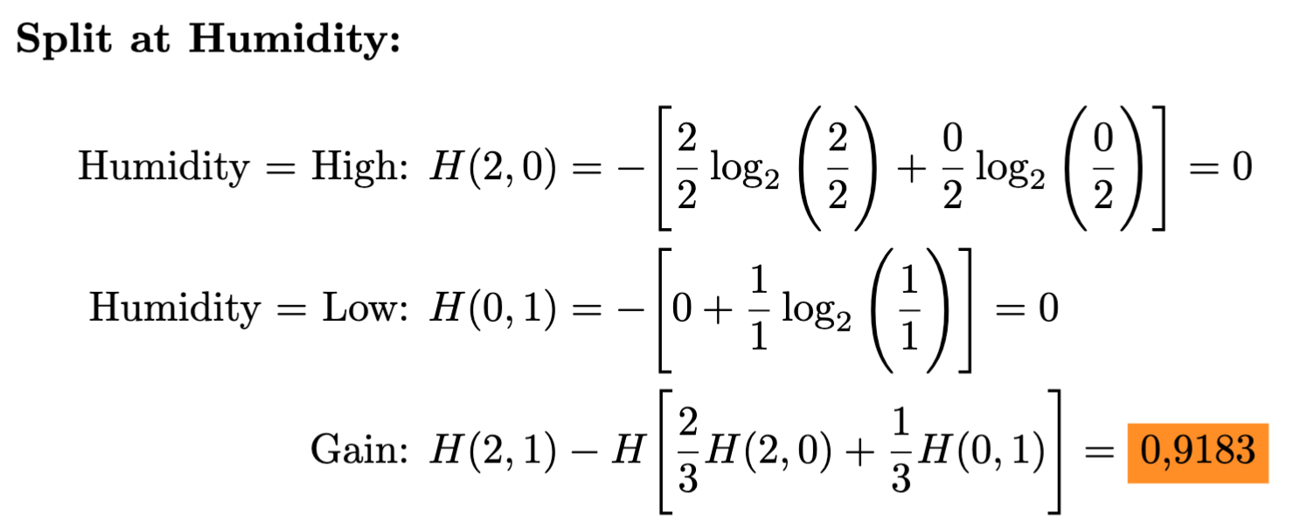
Split subsets – NO RAIN

Slide 15
Final BDT

Slide 16
Testing BDTs
Not all data is used for training
Choose samples from remaining data
Compare yielded results with true result (supervised)

Slide 17
BDT ±
Pros
Can be used to classify data
Classification and regression
Can handle categorical and numerical values
Intuitive and visualizable
Requires only little data pre-processing
Cons
Small changes in data greatly affect prediction
Overfitting
Overfitting → Random Forest
Notes:
What ensemble needs more pre-processing

Slide 18
Random Forest
Combination of multiple BDTs
Final decision through majority vote
Introducing Randomness
Bagging

Slide 19
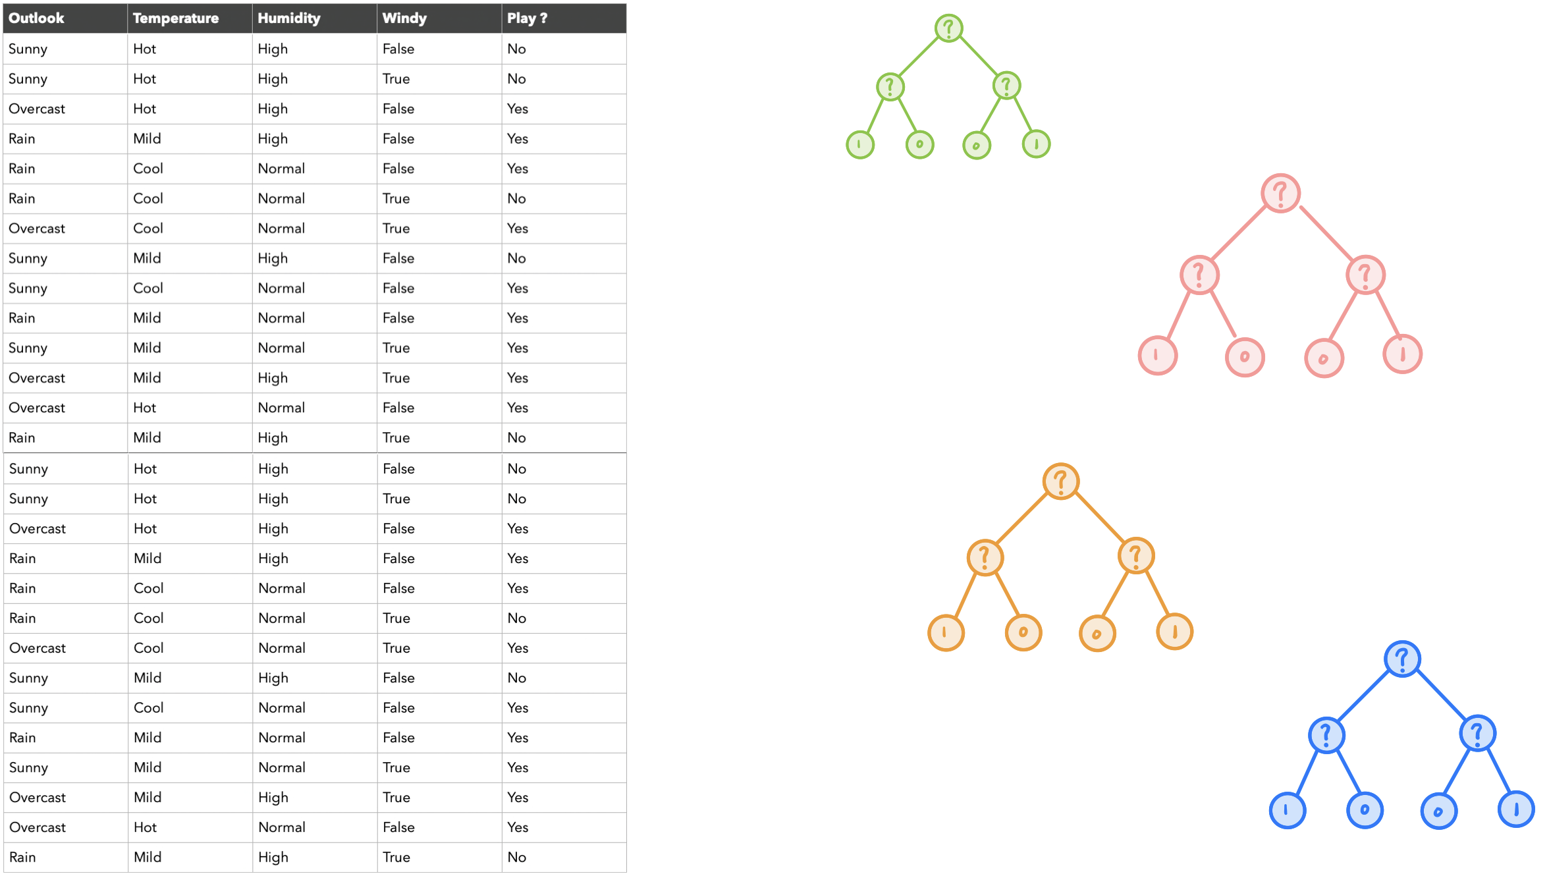
Random Forest - BAGGING
Each tree is trained with individual set of training data
Decision

Slide 20
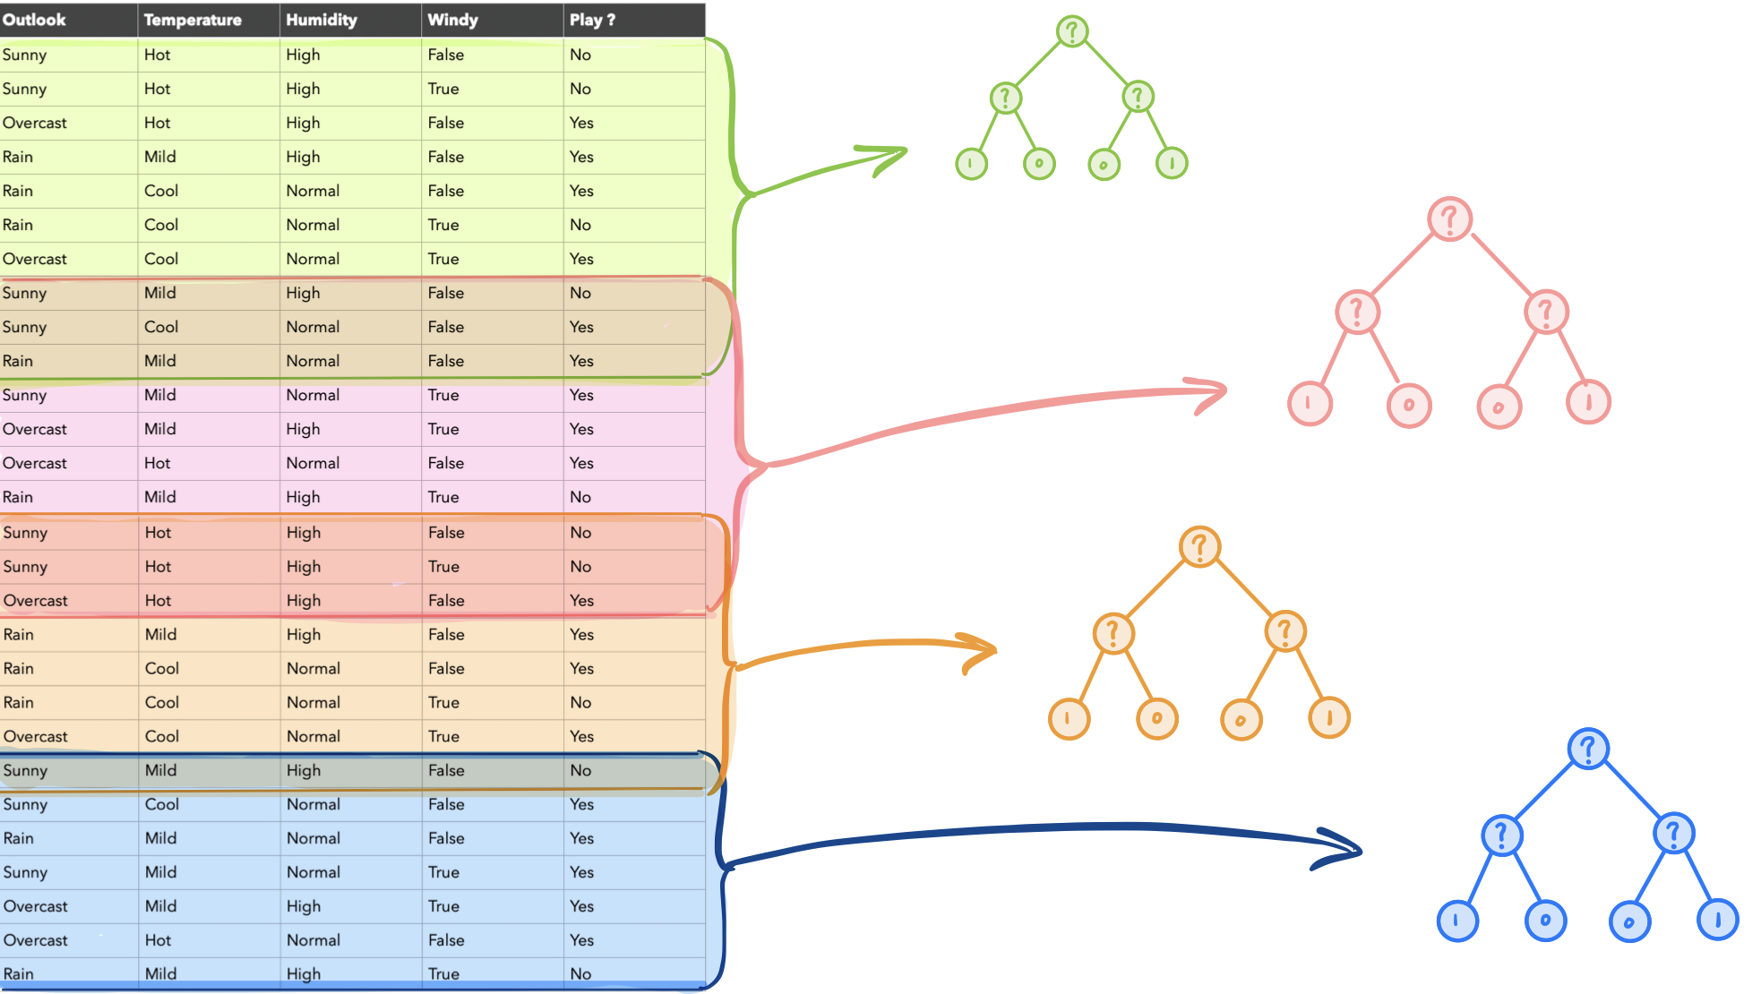
Random Forest - BAGGING
Each tree is trained with individual set of training data
Decision

Slide 21
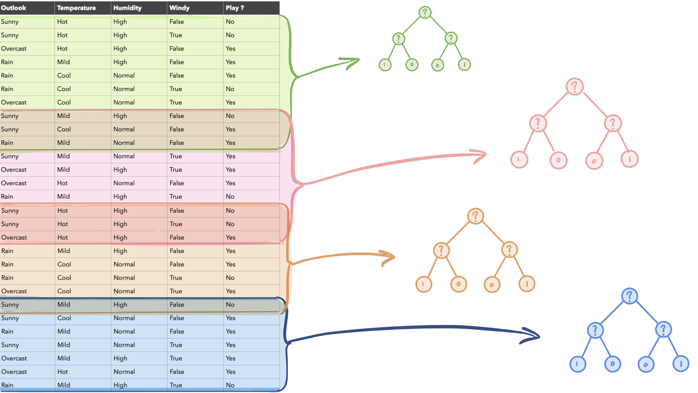
Random Forest – BAGGING + XY
Each tree is trained with individual set of training data & features
Decision

Slide 22
Methods

Slide 23
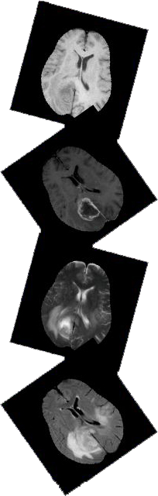
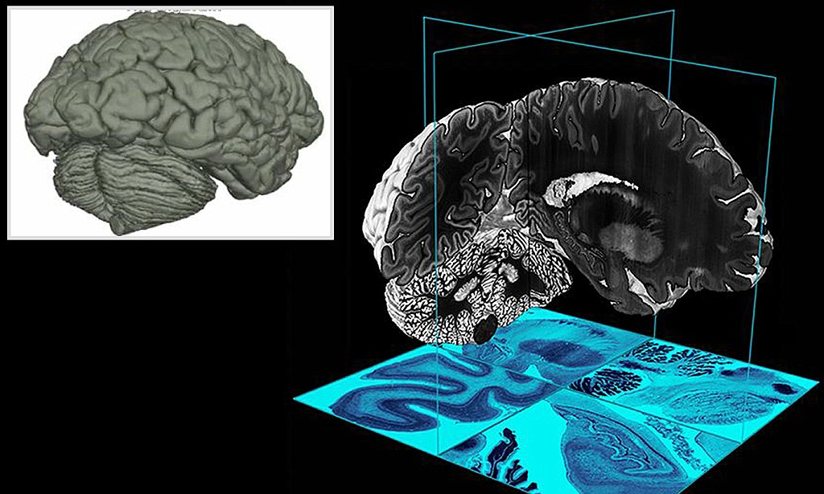
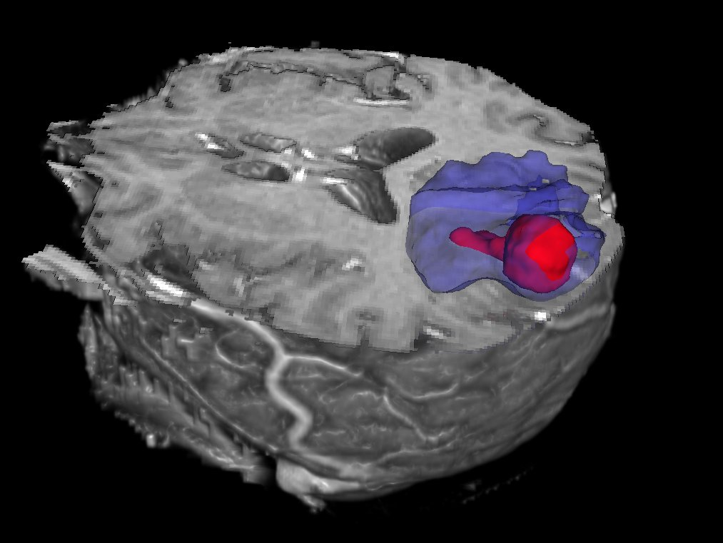
Overview
Volume: 3D-Model of a human brain
Twelve patients
Four different scans (T1, T2, T1C, FLAIR)
1.5 Mio vectors per patient
Truth-image with expert‘s connotations
Separation Tumor, Edema, Negative
http://www2.imm.dtu.dk/projects/BRATS2012/index.html

Slide 24
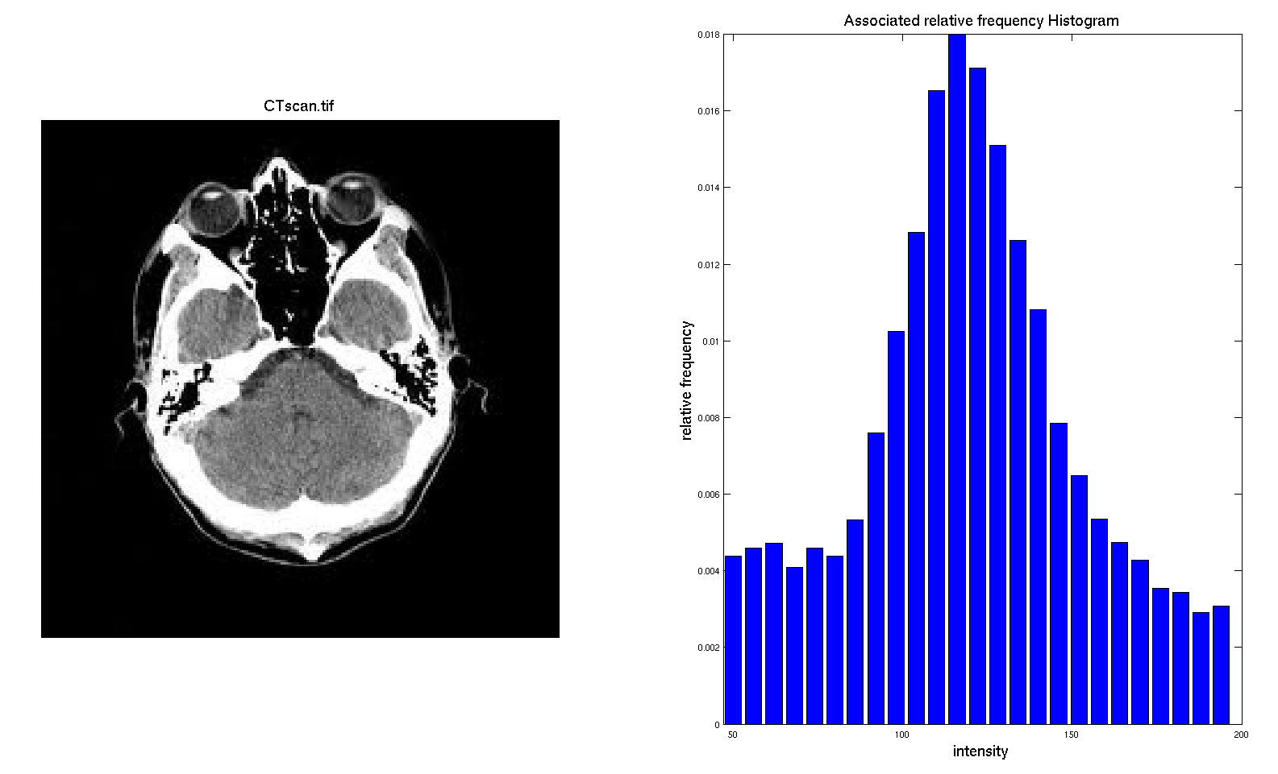
Preprocessing
Histogram Normalization
Lists intensity of each voxel
Moves middle 50% between 600 and 800
Limits 200 – 1200
Computed Features
Voxel intensity values do not carry location information
Add 8 more features (10 Elements & 26 Elements)
Missing Data
Problem: Missing pixels distort average computation of features
Value = 0
Not considered for neighbors
https://www.google.com/url?sa=i&url=http%3A%2F%2Fwww.sci.utah.edu%2F~acoste%2Fuou%2FImage%2Fproject1%2FArthur_COSTE_Project_1_report.html&psig=AOvVaw0hm5pvrxmiO8zrLrqrgMxx&ust=1604956214315000&source=images&cd=vfe&ved=0CAIQjRxqFwoTCNDQy_3t8-wCFQAAAAAdAAAAABAD

Slide 25
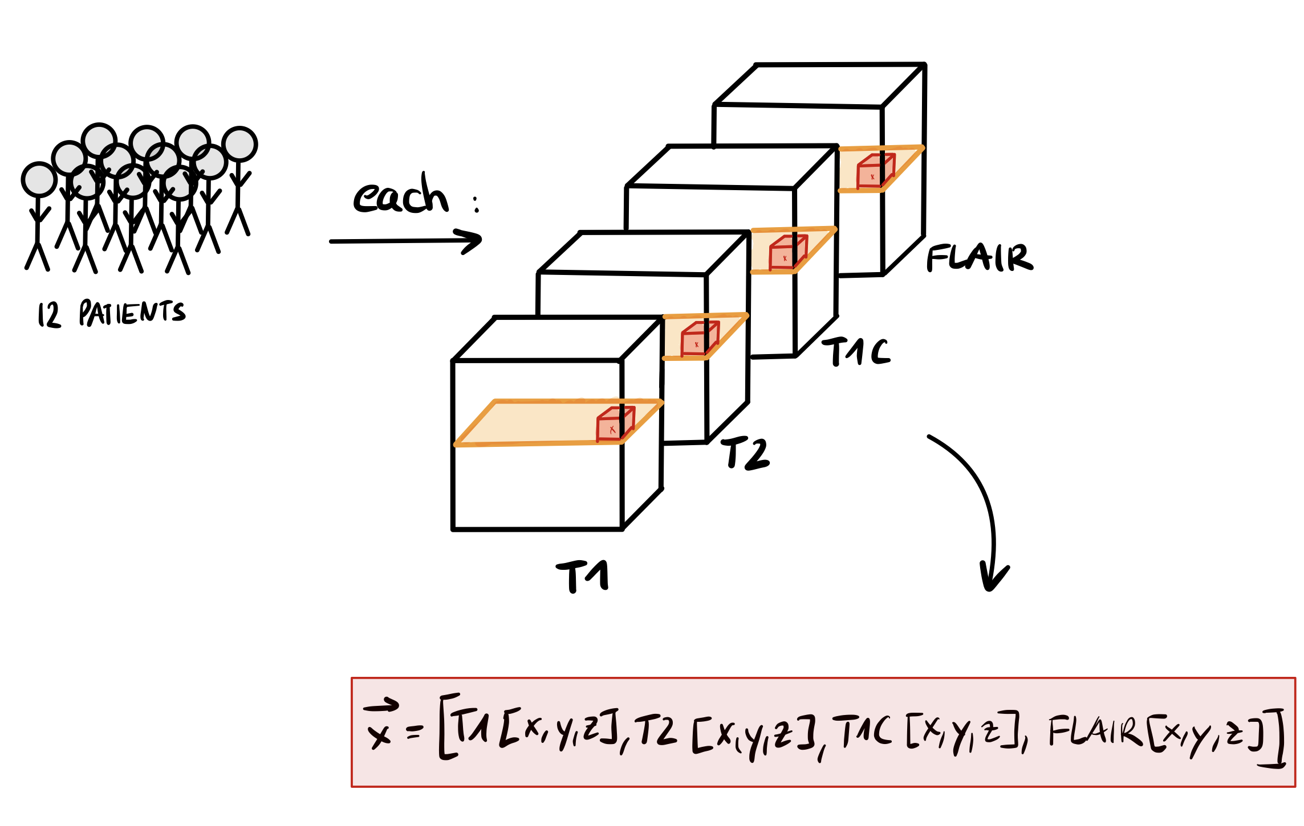
Feature Vector – WITHOUT NEIGHBORHOOD INFORMATION
Way to address a specific voxel…
… in all scans

Slide 26
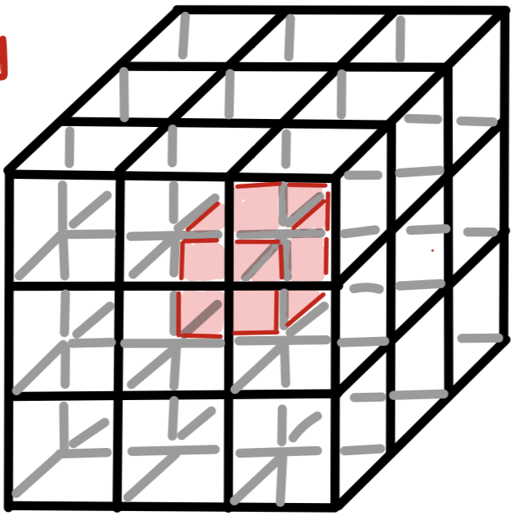
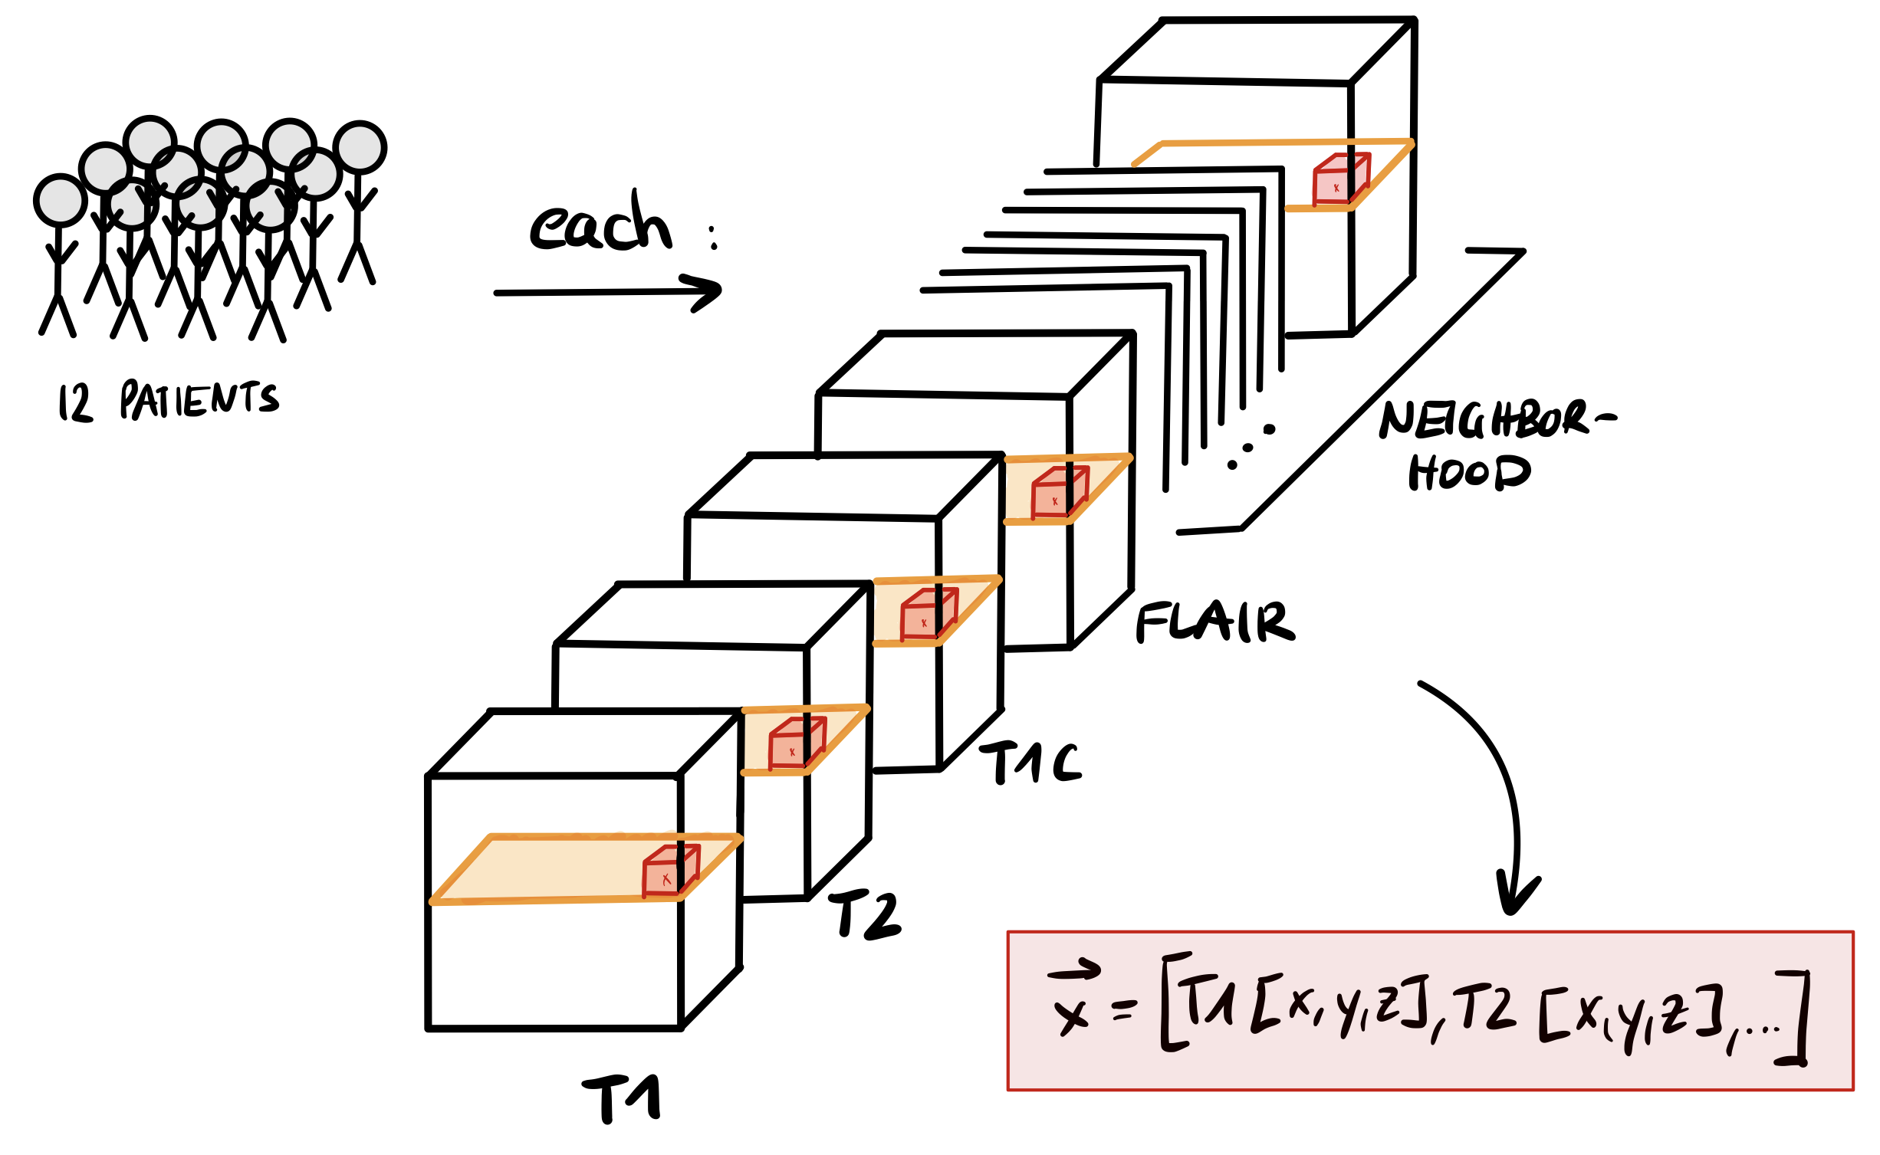
Feature Vector – WITH NEIGHBORHOOD INFORMATION
Way to address a specific voxel…
… in all scans

Slide 27
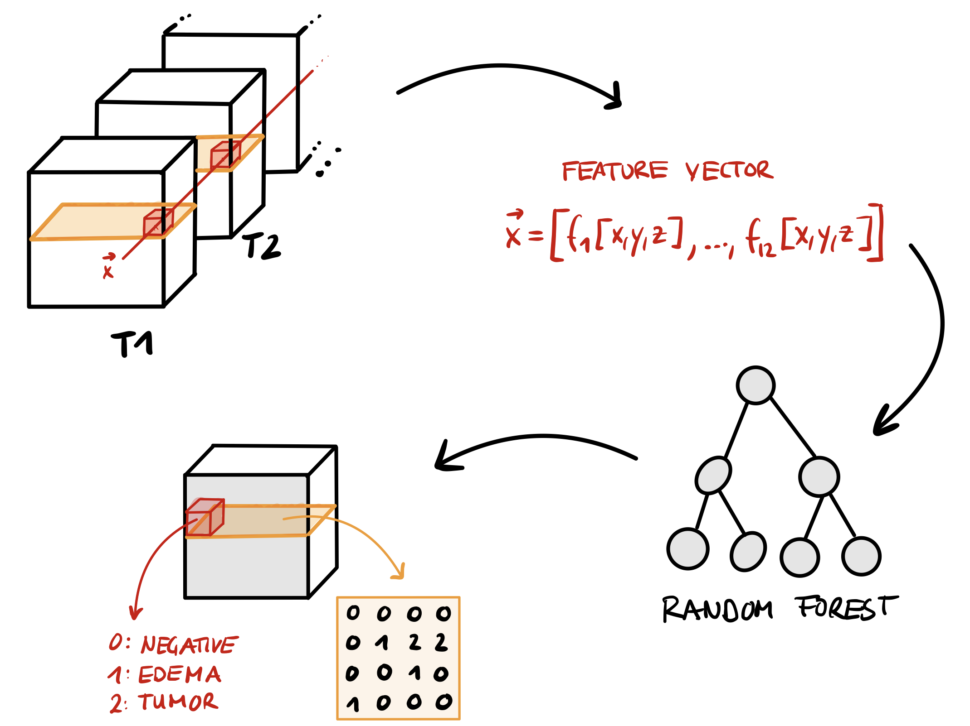
I/O

Slide 28
Post-Processing
Discover false positives
Negative voxels labled as tumor or edema
For each voxel labeld as tumor or edema:
Define 250-voxel neighborhood
Define Threshold
Count number of tumor- and edema-neighbors
If number smaller than threshold, relable as negative

Slide 29
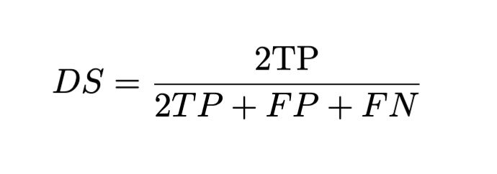
Dice Score
Characterize accuracy of Decision
Value in range: [0,1] → [not accurate, accurate]
TP: True Positives
FP: False Positives
FN: False Negative

Slide 30
Results

Slide 31
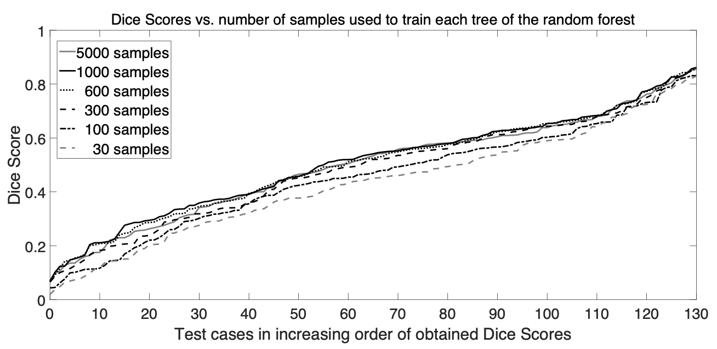
Results: Sample Size
Increasing Sample size leads to higher DS

Slide 32
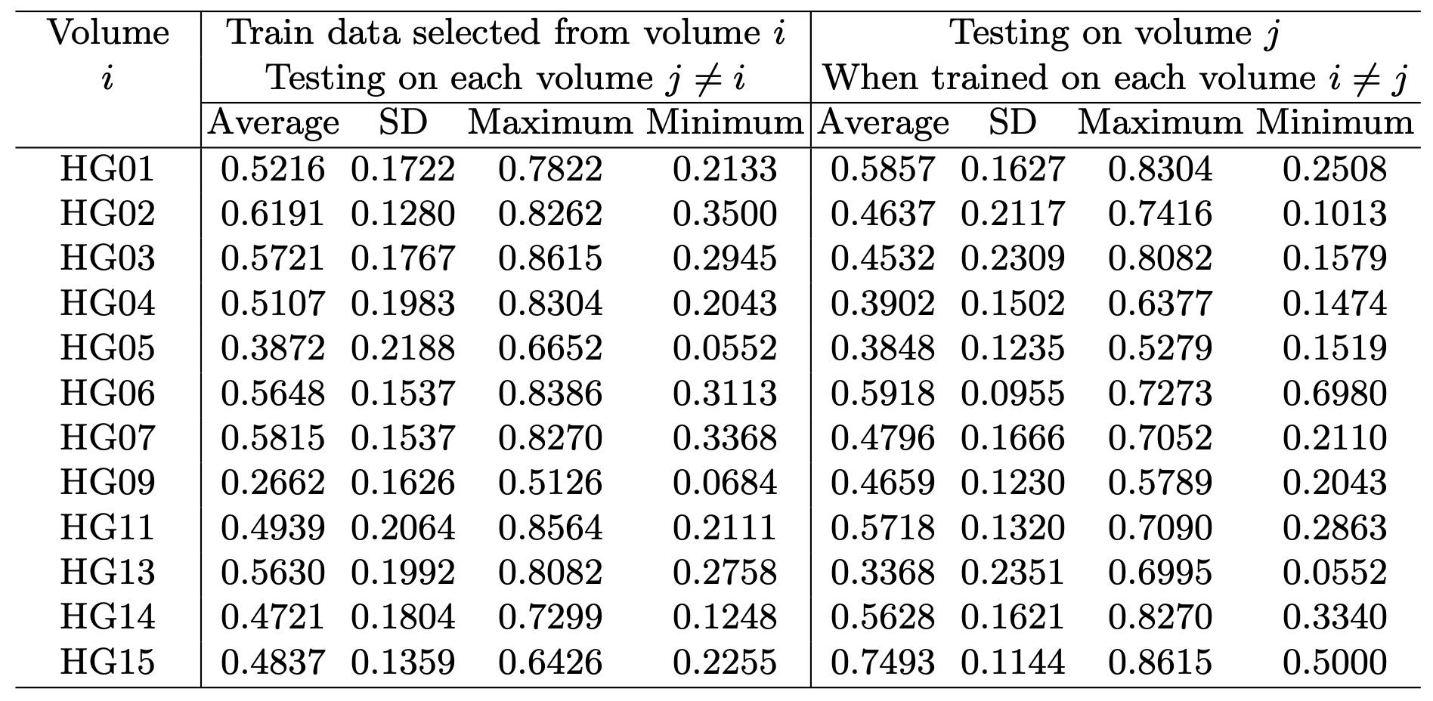
Results: Testing vs Training
No symmetry DS(i → j) ≠ DS(j → i)
Training on one volume is not enough

Slide 33
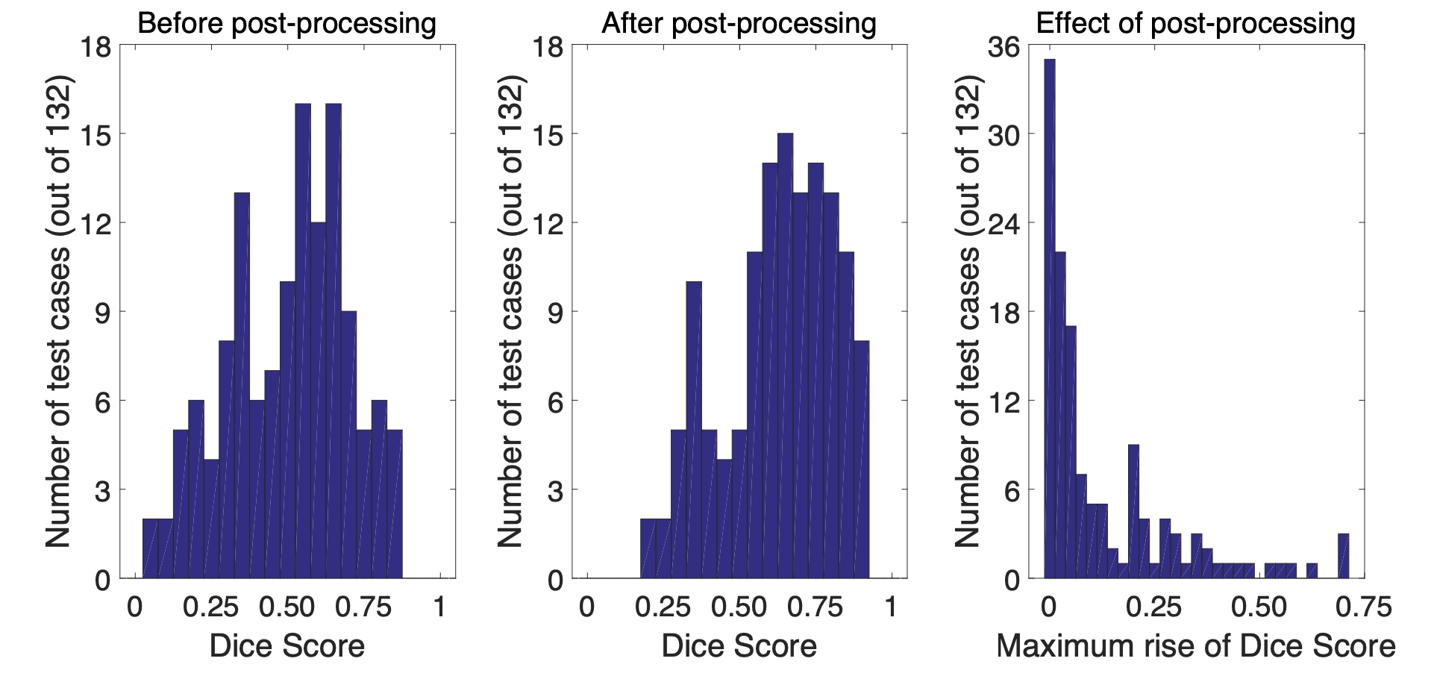
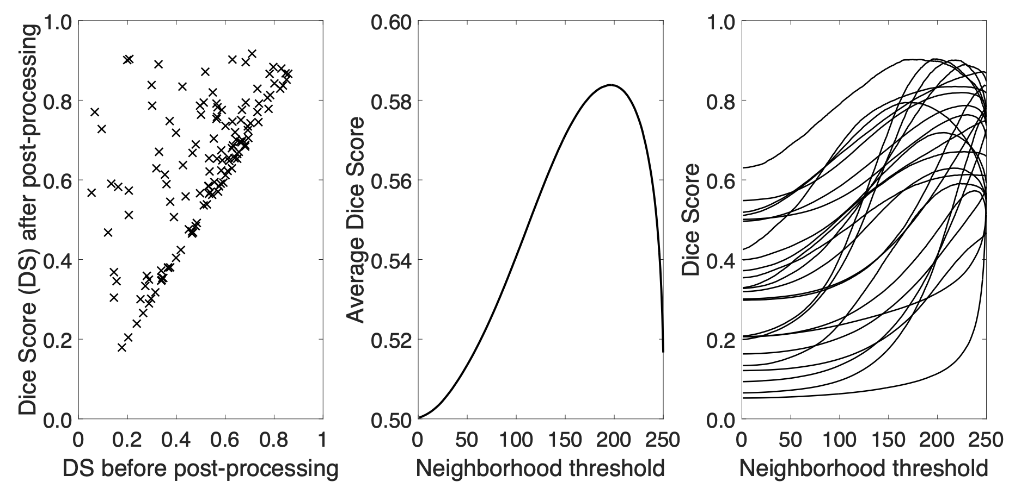
Results: Post Processing

Slide 34
Results: Post Processing

Slide 35
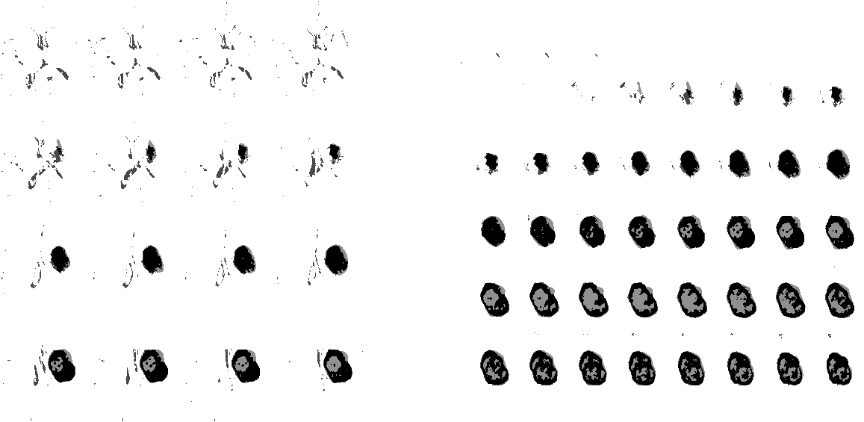
Results: Post Processing
WITHOUT PP
WITH PP

Slide 36
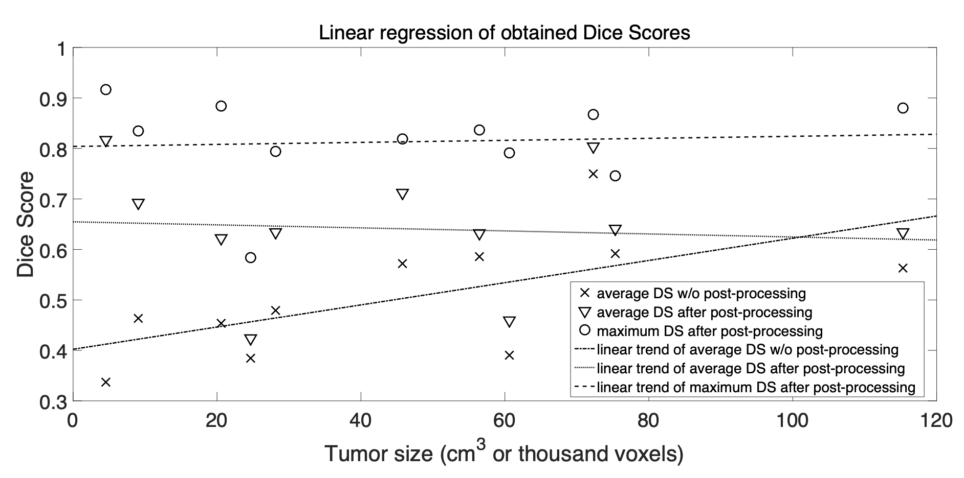
Results: Tumor Size
Post processing works better with small tumors → early detection

Slide 37
Conclusion
RDF trained on one volume → not acceptable
Combination of volumes would be possible
Promising results
Applicable in clinical use

Slide 38
Sources
Zoltán Kapás, 2016, Automatic Detection and Segmentation of Brain Tumor Using Random Forest Approach
Ralf Moeller, 2018, Vorlesung Einführung in Web und Data Science
A. Criminisi, 2011, Decision Forests for Classification, Regression, Density, Esimation, Manifold, Learning and Semi-Supervised Learning
Kahild Usman, 2017, Brain tumor classification from multi-modality MRI using wavelets and machine learning
Wikipedia, 2020, Random Forest

Slide 39

Thank you!

